Slide 1

Knowledge Search Assistants
TDC SUMMIT SÃO PAULO
March 26

Slide 2
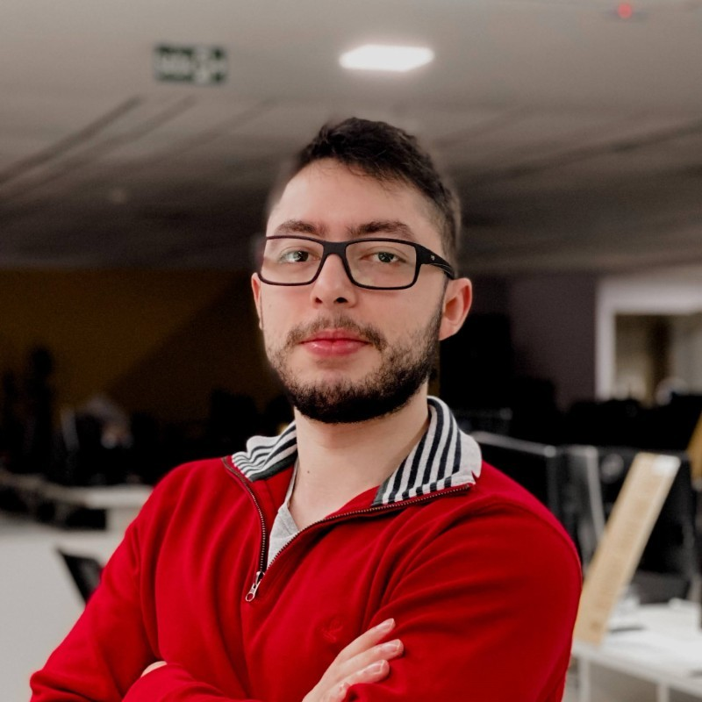



TDC SUMMIT SÃO PAULO
Technology for business transformation
Boris Garafulic
AI Business Manager
Renan Barbosa
Data Scientist Evangelist

Slide 3

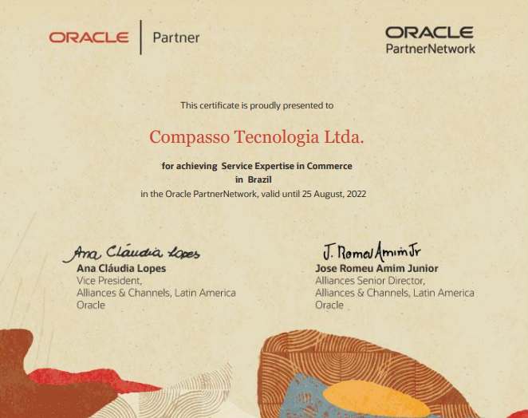
TDC SUMMIT SÃO PAULO
Technology for business transformation
A parceria com a Oracle possui mais de 20 anos e é responsável por alguns dos projetos mais inovadores de transformação digital em operação globalmente.
A Compass UOL foi pioneira no delivery de projetos de várias soluções lançadas pela Oracle ao longo dos últimos anos, permitindo que nossos clientes utilizassem tecnologias de ponta e garantissem a vanguarda de seus negócios.
Somos o primeiro e único parceiro da Oracle na América Latina a conquistar o nível de Service Expertise em Oracle Commerce Cloud.
Mais detalhes da parceria:
https://compass.uol/pt/parceiros/oracle/

Slide 4





AI & ML
Data Products
Data
Platform
Migration & Modernization
Let us guide your data-driven journey

Slide 5






Gen AI Launch Framework: Our steps to deliver Gen AI
Enable
Expand
Enhance
Excel
We assess readiness and indicate which of the following steps should be taken. Optional Proof of Concept (PoC) to expose and educate on the subject. Duration: Without PoC 7 to 15 days. With PoC 15 to 45 days.
For those starting, we provide data management solutions and design and develop an MVP with clear ROI expectations.​ Duration: 60 days.
We scale and improve existing Gen AI products, combining different Data and AI practices for better business outcomes.​ Duration: 100 days.
We build a Center of Excellence with specialists from Compass UOL and your team, easing extended knowledge transfer for taking Gen AI to the next usage level.​ Duration: 160 days.
Notes:
I've highlighted the ones I see make more sense here.

Slide 6







Accelerators and use cases to apply Generative AI smarter and faster
.
Conversational product recommendation
Knowledge Base Search with GenAI
Content Generation with Gen AI
Based on user input, it's possible to create a conversational product recommendation experience for a specific user, integrated into the client's catalog.
Chatbot to efficiently access the company's internal database, allowing users to request specific information through the chat interface.
Leveraging Generative AI, this solution automates content creation for websites, blogs, or platforms, ranging from product descriptions to complete articles.
Conversational AI for Customer Support with Gen AI
GenAI-Powered
Q&A Solution
SEO Optimizer with GenAI
Integrates GenAI to provide automatic responses to support queries. It connects with knowledge bases, streamlining issue resolution without human intervention.
Simplifies the Q&A system with accurate responses and a personalized search interface, using GenAI to match user questions to relevant articles quickly.
GenAI acts as a data generator, providing SEO information like titles, descriptions, and keywords in JSON format for each item, enhancing overall site SEO.
Automated Legal Document Analysis with GenAI
Sentiment analysis of customers reviews
Biometric Recognition for Payment Authentication
Automates legal document analysis, interpret, extract data, identify key information, summarize and generate concise summaries.
Process textual data from reviews on platforms, identifying sentiments and offering insights. Helps in understanding the reception of products or services.
Analyze facial features in images for user registration and authorization.
6
Notes:
Assists customers by providing personalized product recommendations, simplifying the order process without navigating through multiple pages.

Slide 7










Conversational AI with GenAI
Demo: Retrieval Augmented Generation (RAG)
Channels
PIX
WhatsApp
Data Sources
Credit or Debit cards
Instagram
Error Messages
Unsatisfactory response or low confidence in the intention
NLP/NLU/NLG
Data Sources
Website
Cashback
Users
GenAI (LLM)
App
Investments
Data Sources
Telegram
Loans
IVR
Data Sources

Slide 8
Motivation
Technology for business transformation

Slide 9
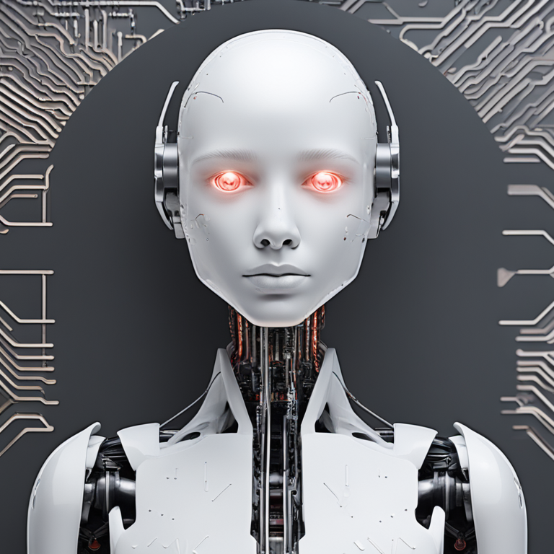
TDC SUMMIT SÃO PAULO
Technology for business transformation
Knowledge Whisper
Tickets response improved efficiency
Jump-start projects by recovering of similar ones in organization;
Recover scientific papers references in academic writing;
Fact checking news/social media posts;
Gerado em https://replicate.com/stability-ai/sdxl usando o prompt: generative ai knowledge whisper bot

Slide 10
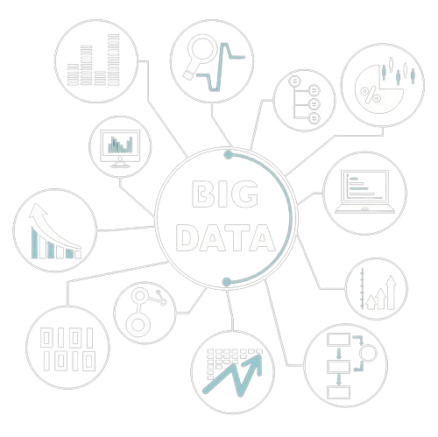


TDC SUMMIT SÃO PAULO
Technology for business transformation
Knowledge Search Virtual Assistants
Supercharge your chatbot:
Improved Customer Experience: Natural conversation flow and open-ended questions make interactions more user-friendly and engaging.
Reduced Customer Effort: Open-ended questions allow chatbots to gather necessary details, streamlining the resolution process;
Increased Self-Resolution: By guiding users through troubleshooting steps or offering relevant knowledge base articles in natural language, chatbots can empower customers to resolve issues independently. This frees up human agents to handle more complex cases.

Slide 11
RAG 1on1
Technology for business transformation

Slide 12
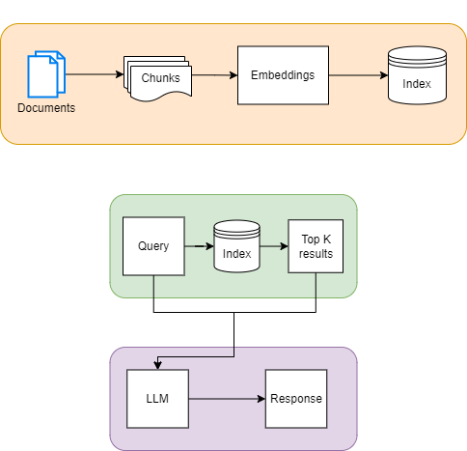
TDC SUMMIT SÃO PAULO
Technology for business transformation

Slide 13
Hands On!
Technology for business transformation

Slide 14
Optimization
Technology for business transformation

Slide 15
TDC SUMMIT SÃO PAULO
Technology for business transformation
Does the model output adhere to the questions in context?
Prompt Tuning
Data Quality
LLM Selection
Answer
Is the model responding fully and comprehensively?
Context
Embedding Model
Data Quality
Are the retrieved chunks being correctly assigned to responses?
How much of it is being used in the model's responses?
Chunks
Prompt Tuning
Chunk Size Tuning
Similarity Method

Slide 16


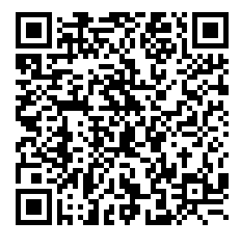
Experimente o poder da IA gratuitamente na nuvem
Conheça os recursos de IA e ML da Oracle Cloud com o Modo Gratuito.
São US$ 500 em créditos para você usar durante 30 dias – uma condição EXCLUSIVA para visitantes do TDC Summit São Paulo!

Slide 17
Thank you!

